Slide 1
Introduction to Robotics
AI4ALL

Slide 2
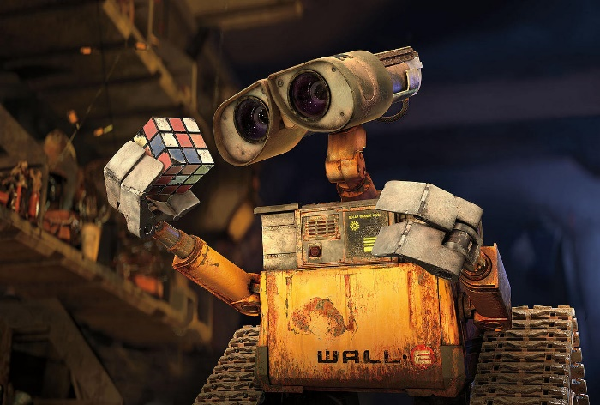
Societal Perception of Robots

Slide 3

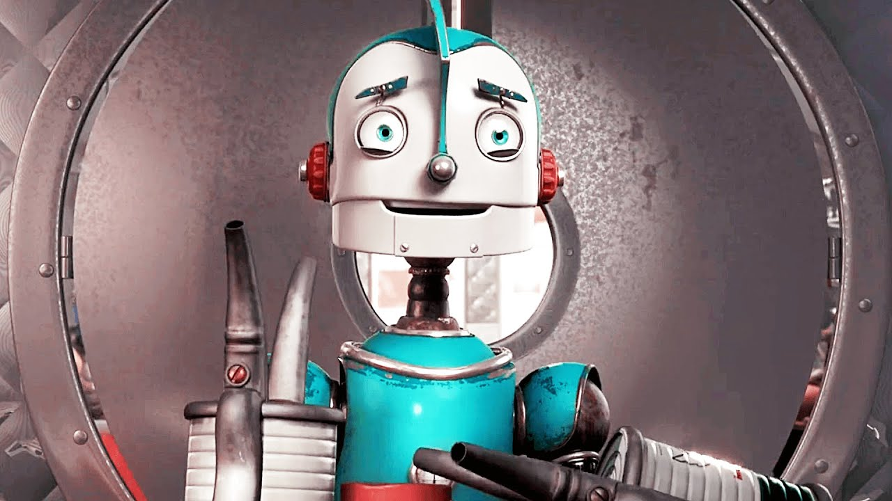
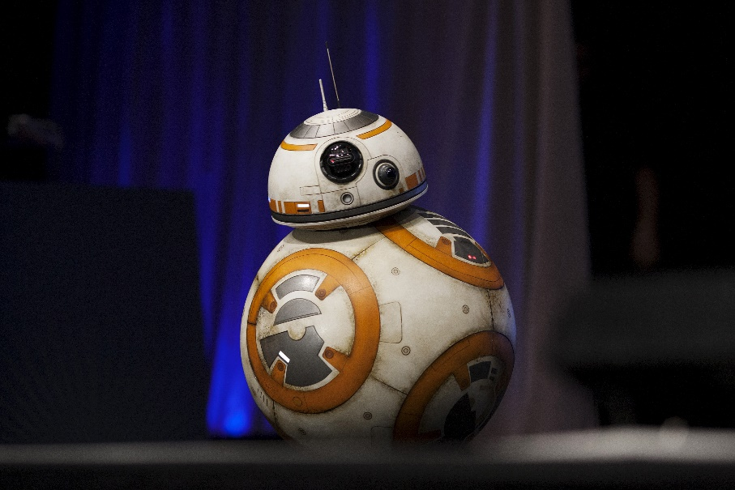
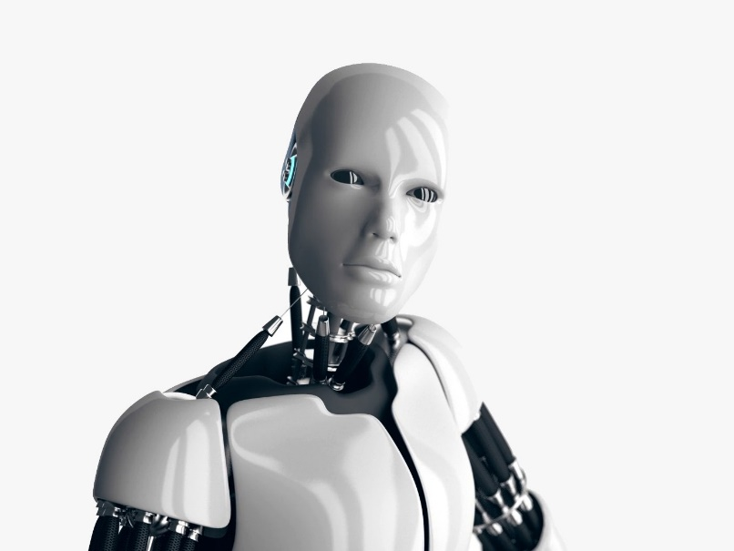
Societal Perception of Robots

Slide 4
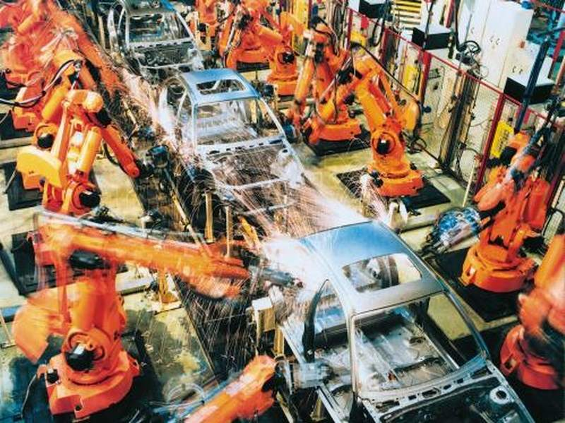
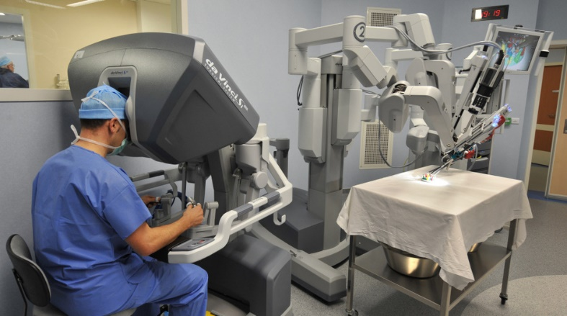
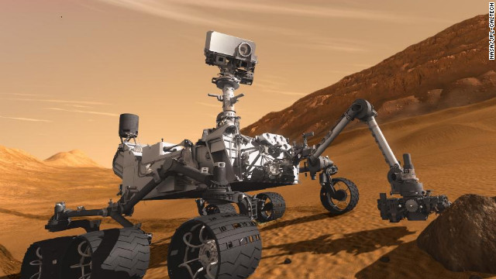
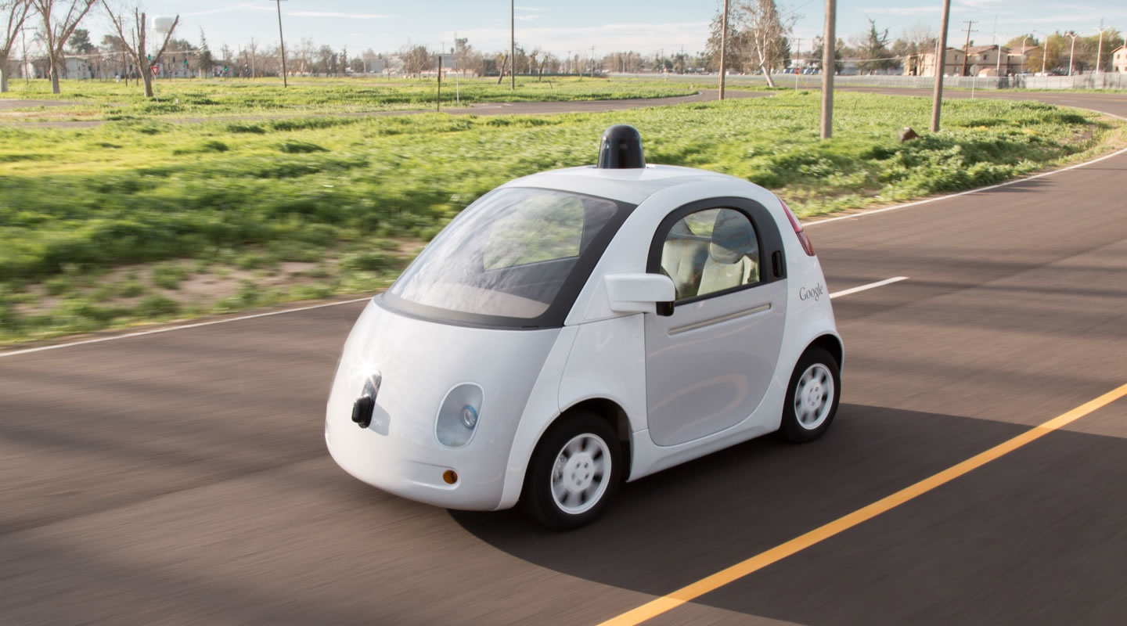
Examples
Notes:
A robot (also called a droid) is a machine —especially one programmable by a computer— capable of carrying out a complex series of actions automatically

Slide 5
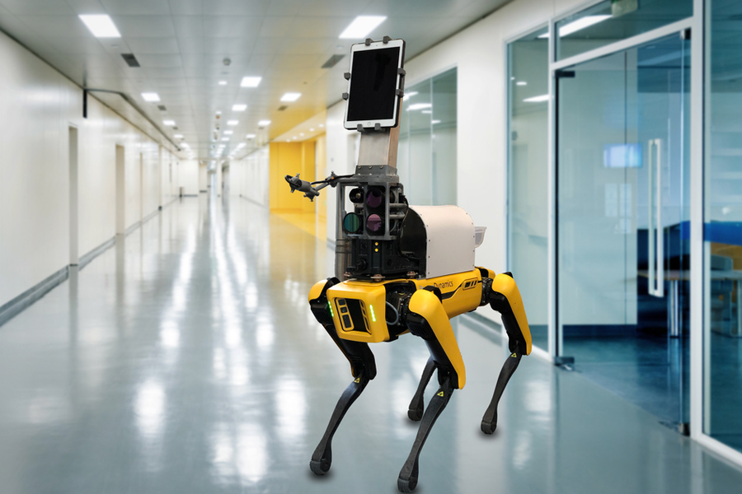
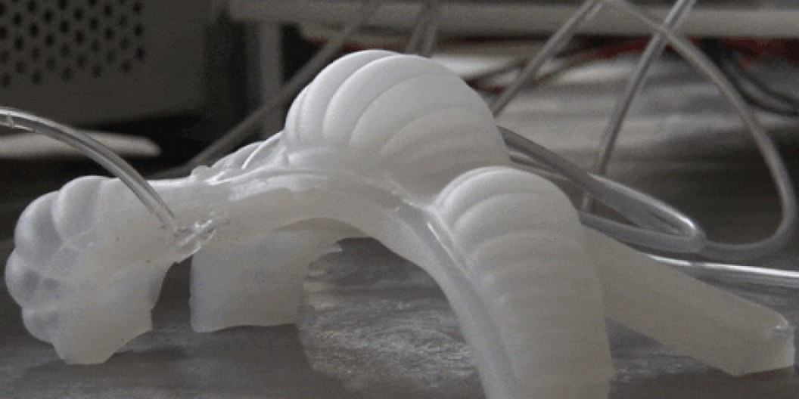
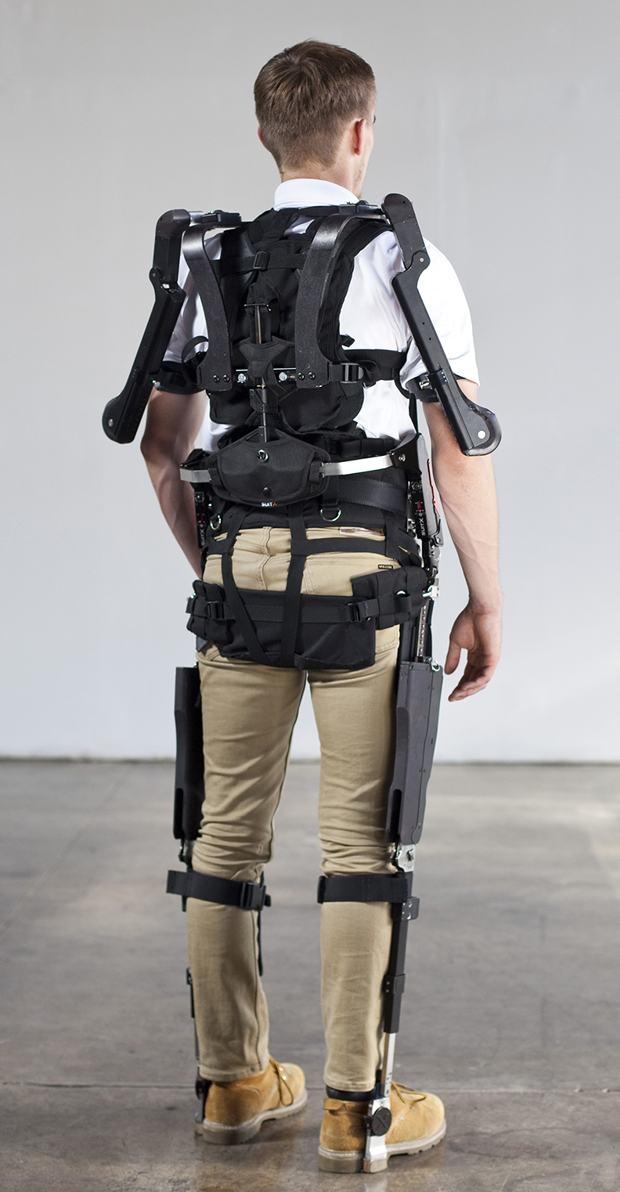
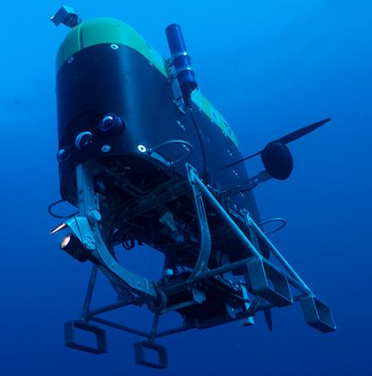
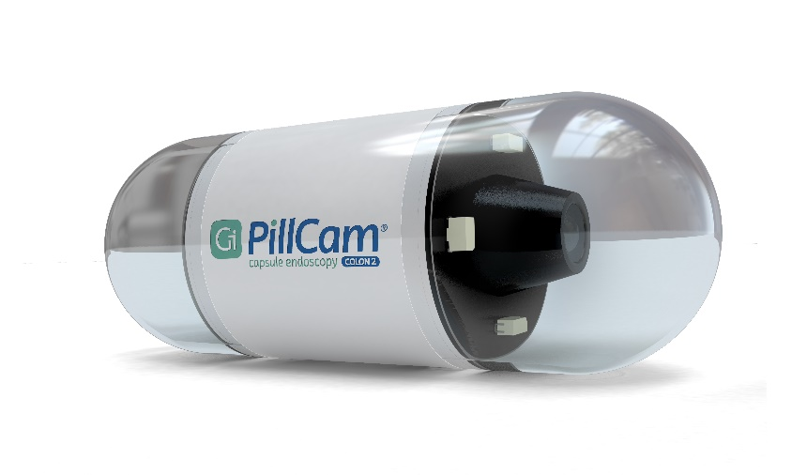
Examples (cont)

Slide 6
Where do you encounter robots in your life?

Slide 7



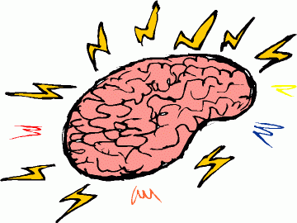
What is a Robot?
Environment
Sensors
Actuators
Computer “Brain” (AI)

Slide 8
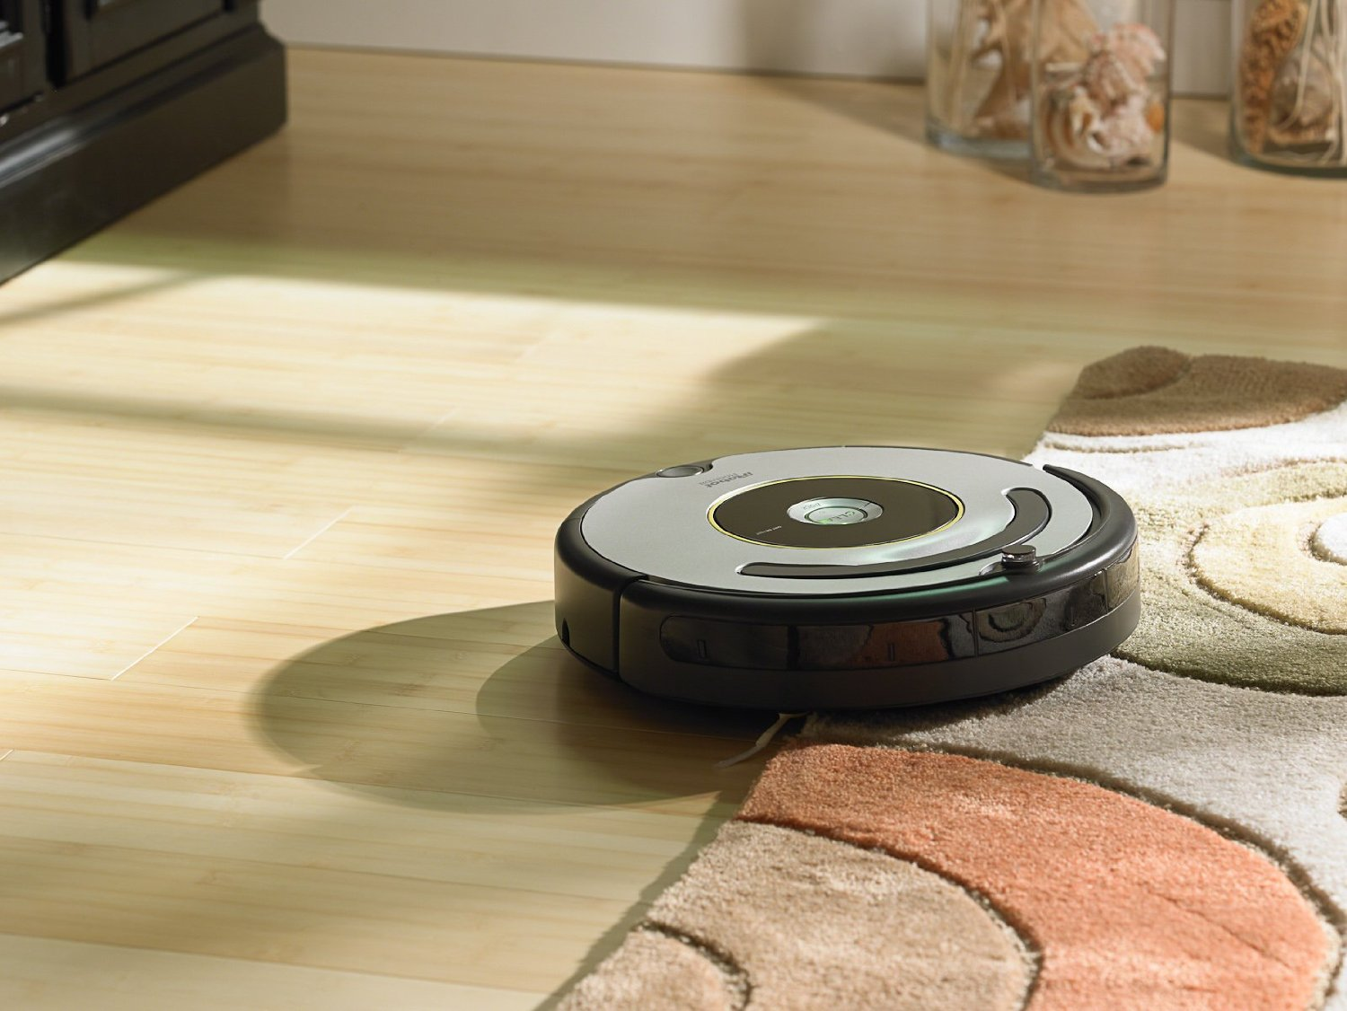
Sensors and Actuators

Slide 9
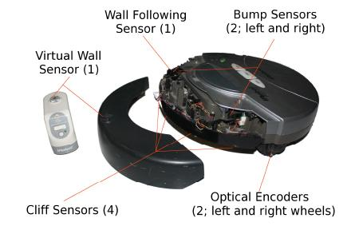
Sensors and Actuators
Notes:
Wall sensors. Sensors are not just necessary to learn about external environment, but also about internal information such as using optical encoders to measure wheel speeds for accurate navigation.

Slide 10
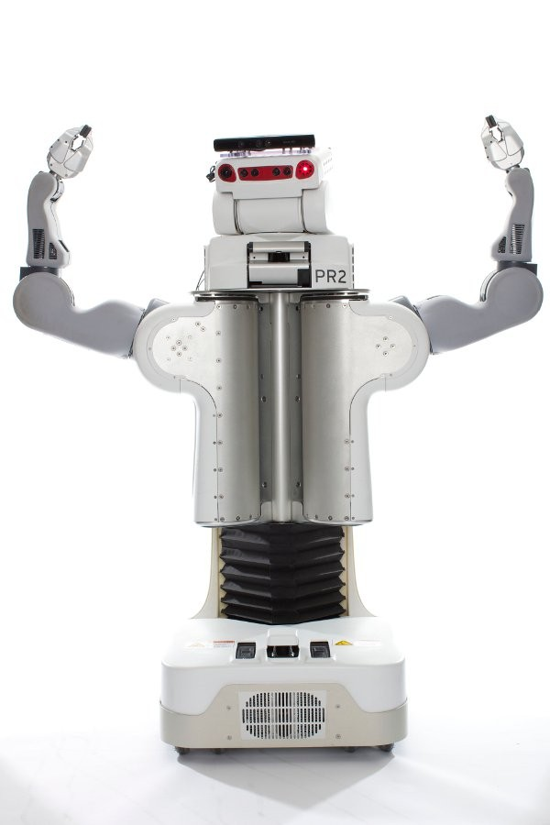
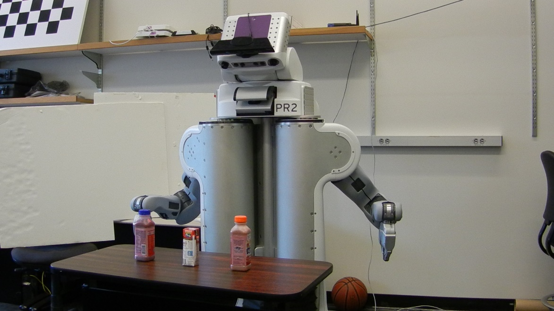
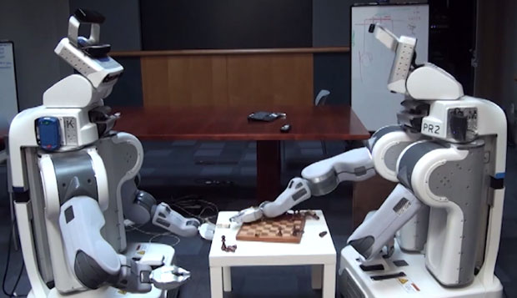
Sensors and Actuators

Slide 11
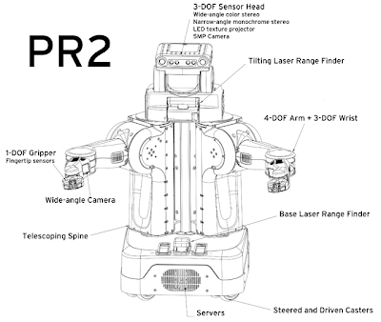
Sensors and Actuators

Slide 12
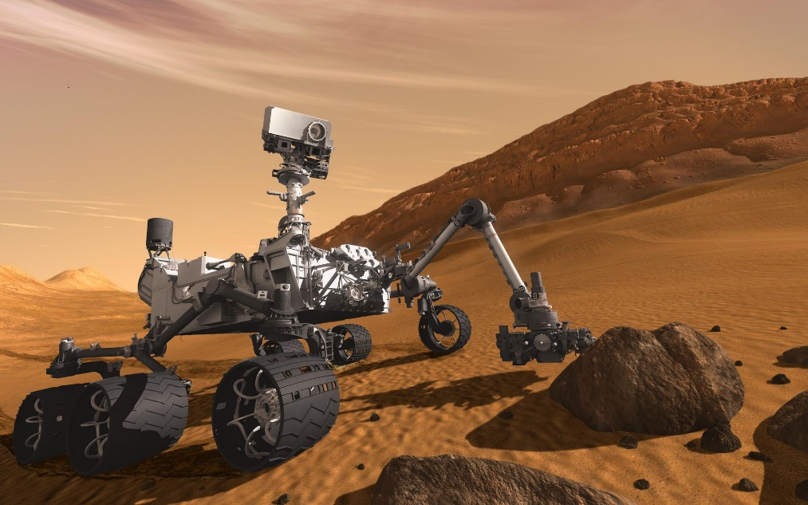
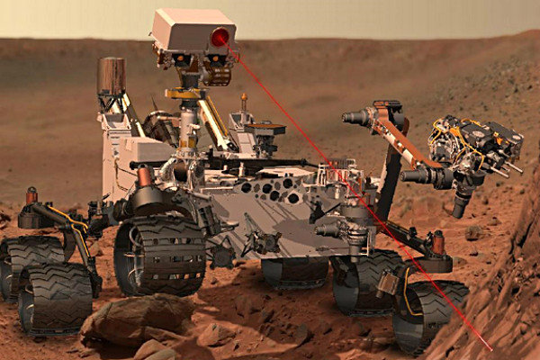
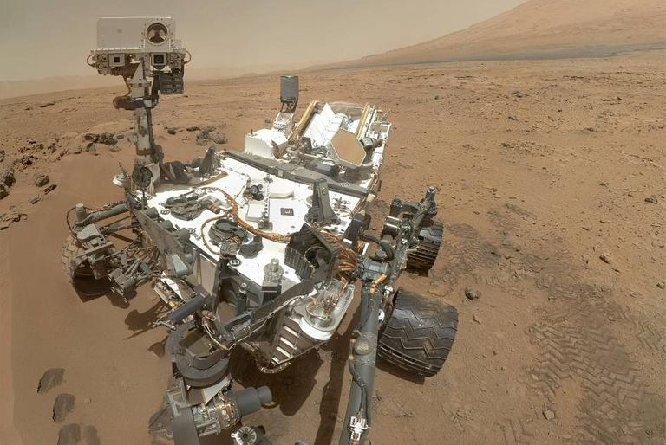
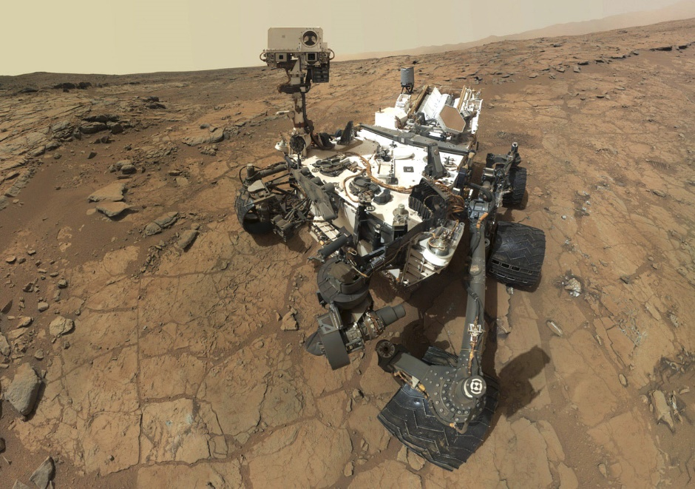
Sensors and Actuators
Notes:
6 20” wheels that are independently actuated for climbing in soft sand and scrambling over rocks.
Robotic arm.
Two pairs of navigation cameras,
Four pairs of hazcams for obstacle avoidance.

Slide 13
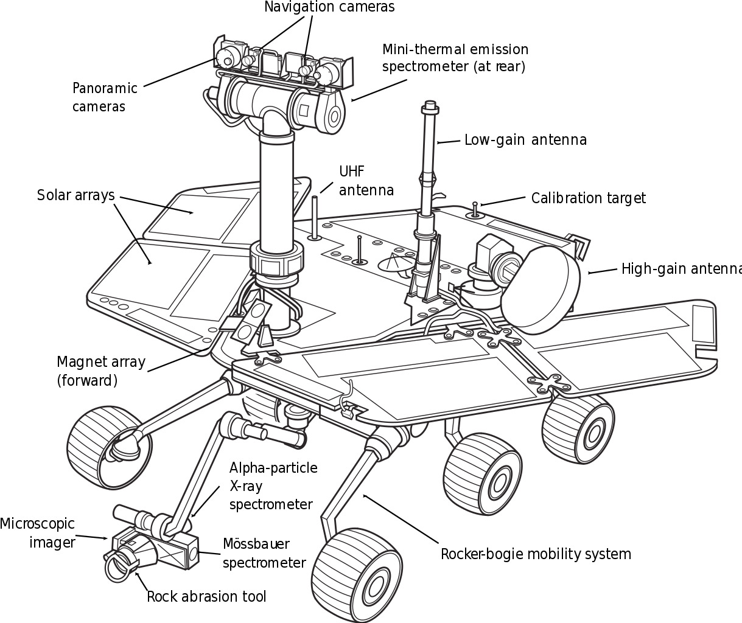
Sensors and Actuators

Slide 14
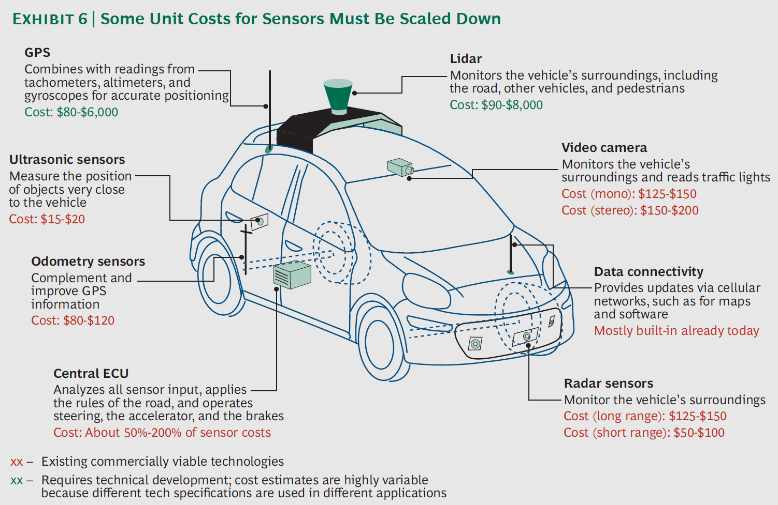
Inside an Autonomous Car
Notes:
Automated steering
Automated braking
Automated Throttle
User interface

Slide 15
Thought Exercise
What sensors are important for an autonomous flying vehicle? Drone, plane, etc.

Slide 16
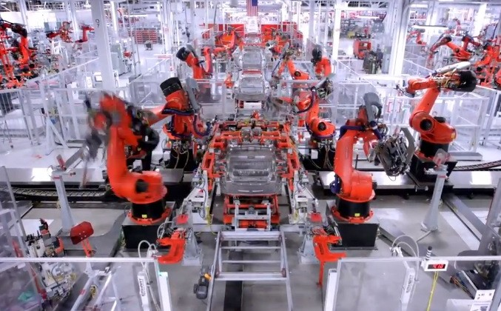
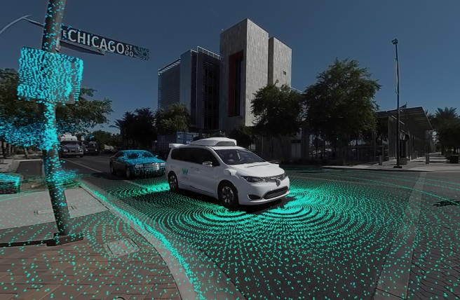
Automation vs. Autonomy
Automation
Autonomy
Notes:
Automation: little or no human operator involvement
Autonomy: systems have a set of intelligence-based capabilities or learning adaptive capabilities that allow it to respond within a bounded domain to situations that were not pre-programmed

Slide 17
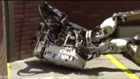
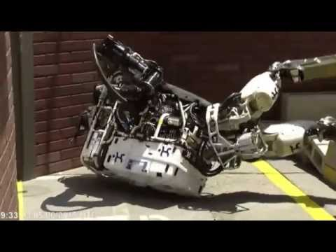
When Robots Go Wrong
https://www.youtube.com/watch?v=-G3RoBHMu-o

Slide 18
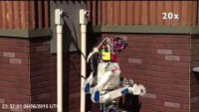
DARPA Robotics Challenge

Slide 19
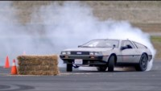
Autonomous drifting

Slide 20
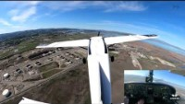
Autonomous gate to gate flight

Slide 21
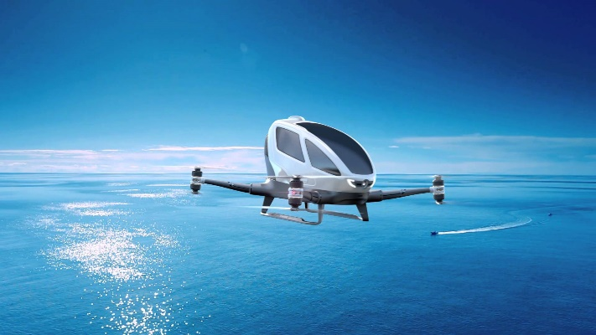
Autonomous Vehicles
History
Current trends
How can autonomous vehicles help humanity?

Slide 22
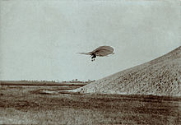
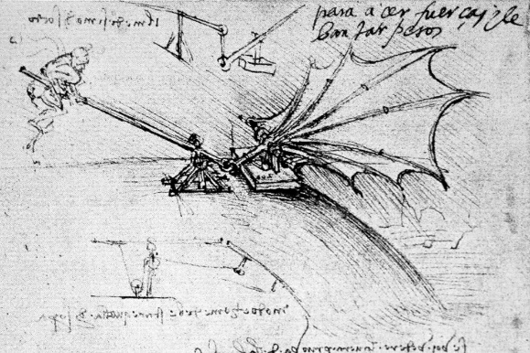
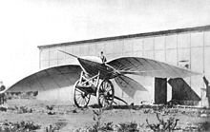
Invention of the Plane
1502: Da Vinci
1895: Otto Lilienthal
1868: Le Bris and glider (Albatros II)
Notes:
an experimental steam-driven artillery tractor, 1769
invented the first crude electric carriage, powered by non-rechargeable primary cells
put a liquid-fuelled internal combustion engine on a simple handcart which made him the first man to propel a vehicle by means of gasoline 1870

Slide 23
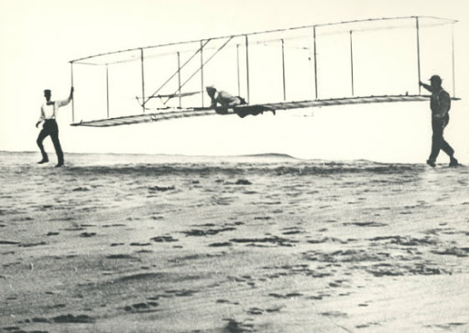
Invention of the Airplane
1903: Wright brother’s first flight
Notes:
the first car to go into production with an internal combustion engine

Slide 24
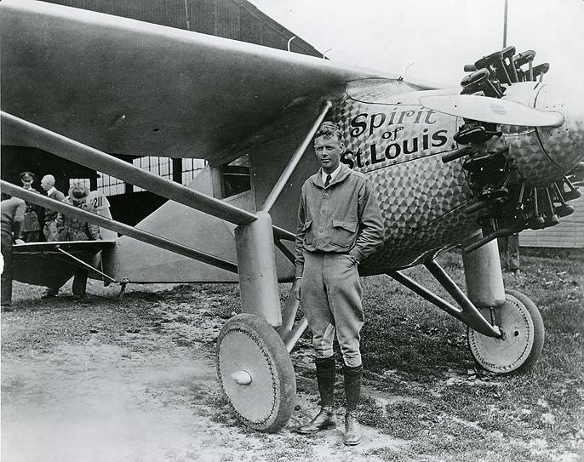
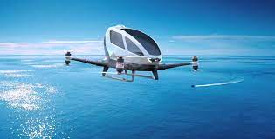
Innovation
Notes:
No big innovation for the past 130 years

Slide 25
Thought Exercise
How do you feel about riding an autonomous car?
How about an autonomous plane?

Slide 26
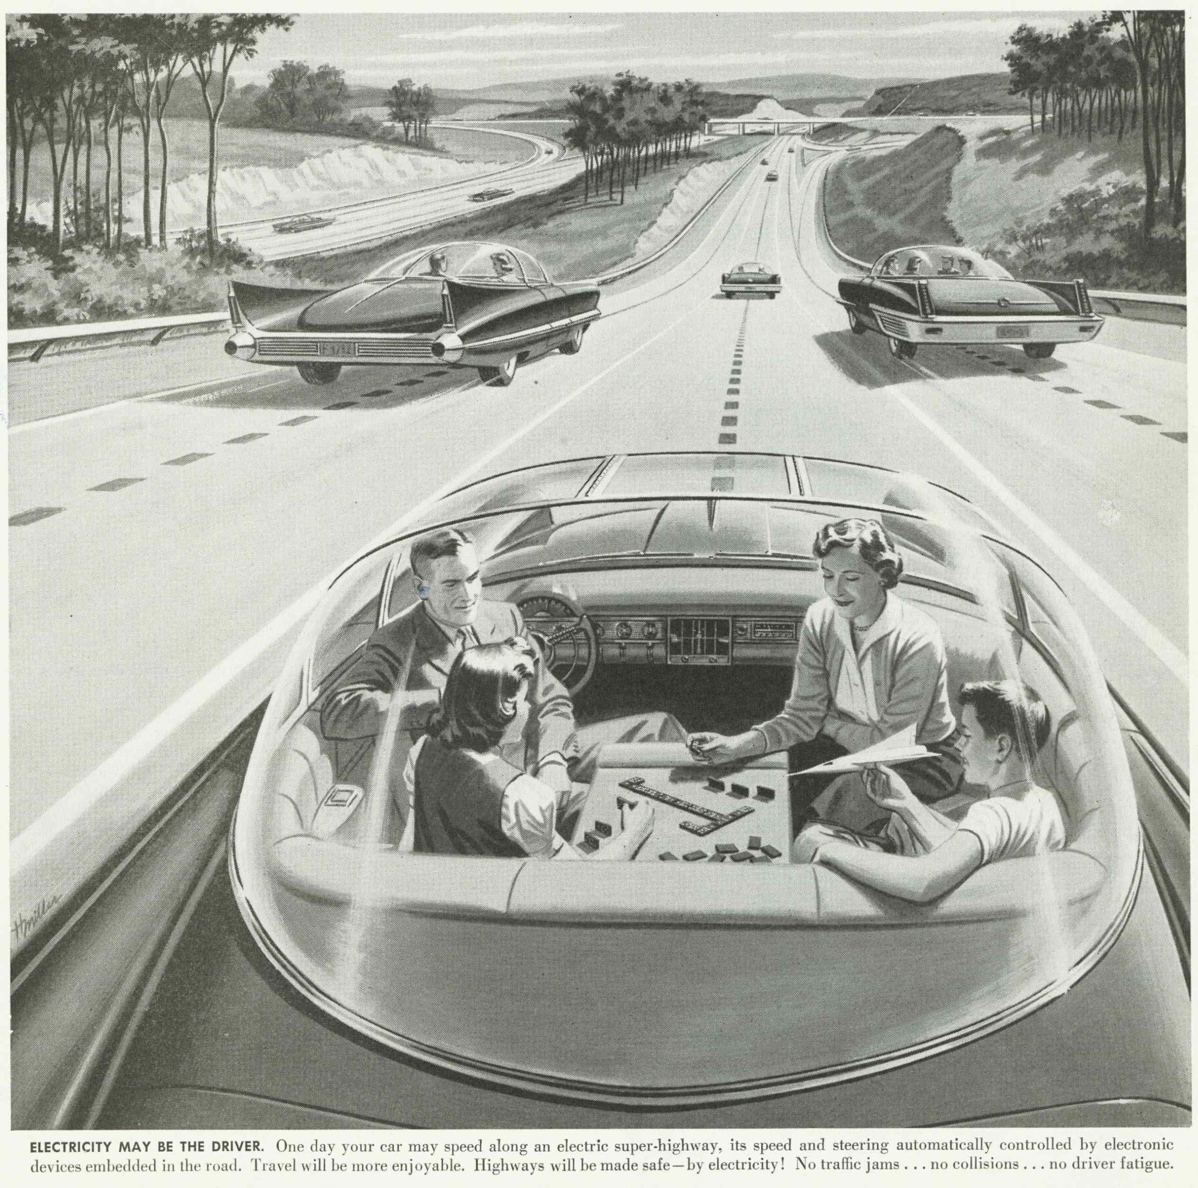
The Vision of Autonomous Vehicles?
Notes:
1956

Slide 27
Thought Exercise
How do you feel about riding an autonomous car?
How about an autonomous plane?

Slide 28
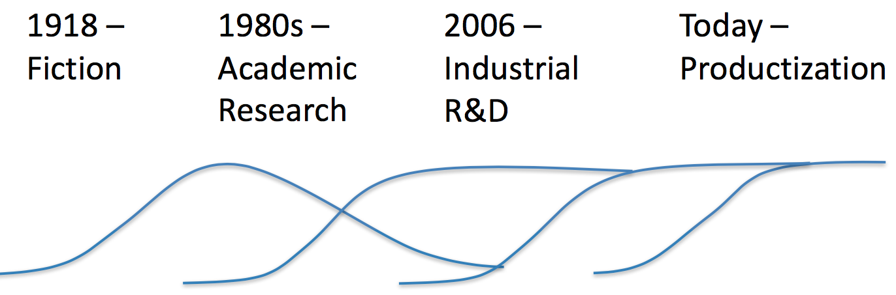
An Old Dream Coming True
Notes:
The key driver is the computing power

Slide 29
DARPA Grand Challenge
2004: First DARPA Grand Challenge
150 mile course in the Mojave Desert
Furthest distance completed: CMU Red Team (11.78km)
2005: Second DARPA Grand Challenge
Winner: Stanley – Stanford University
2007: DARPA Urban Challenge
60 mile urban course – must obey traffic regulations
Winner: “Boss” – Carnegie Mellon University
2nd Place: “Junior” – Stanford University

Slide 30
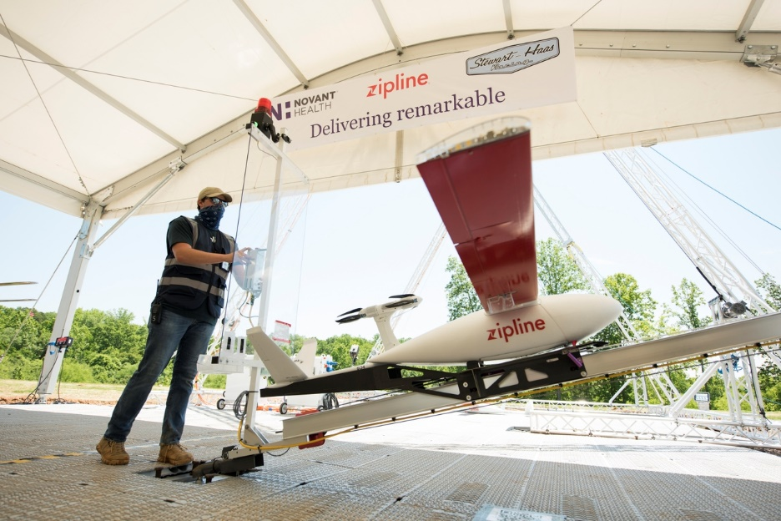
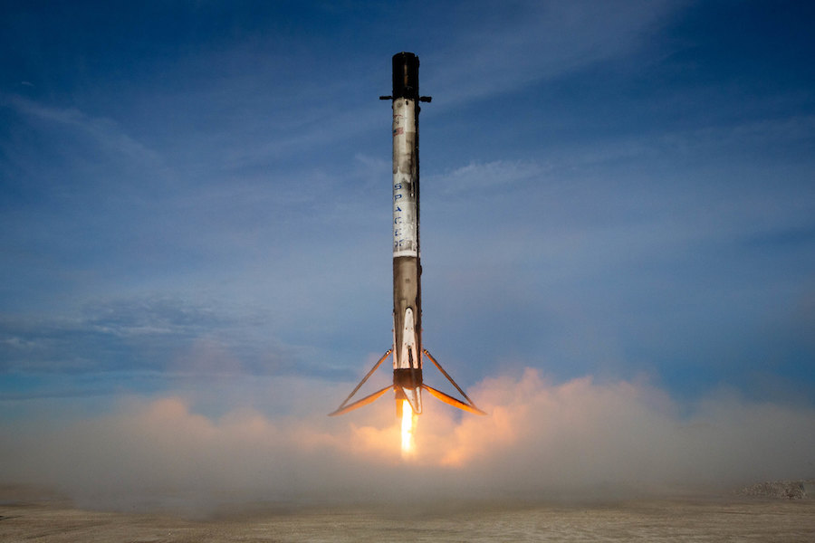
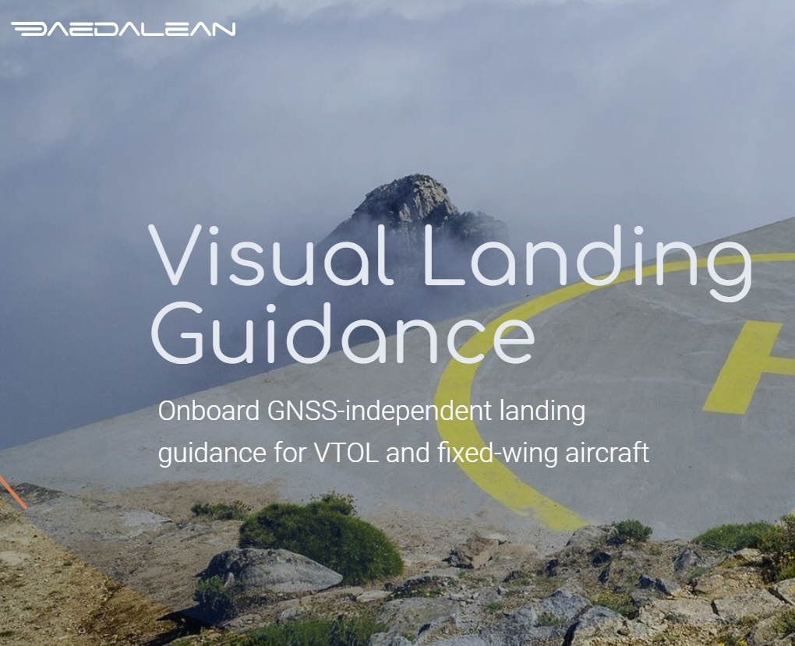
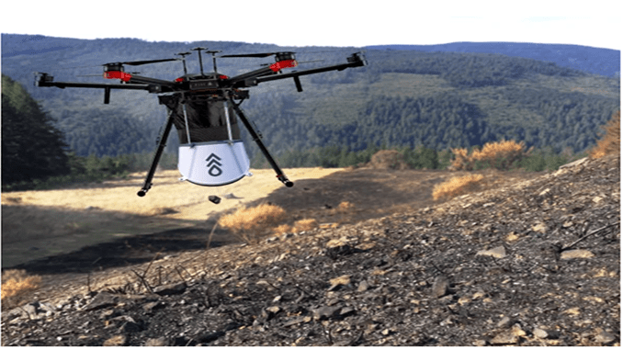
Current Trends

Slide 31
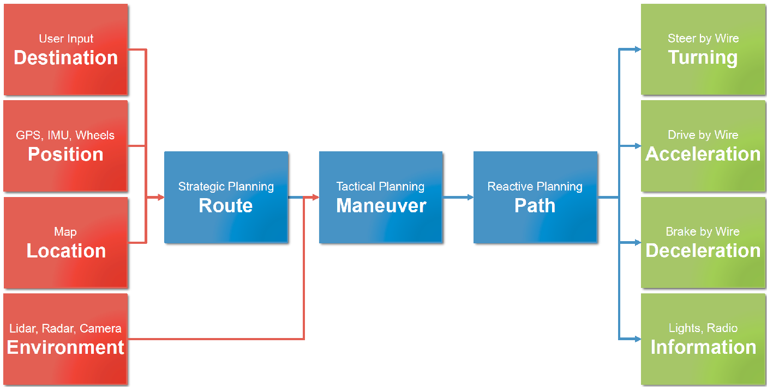
Inside an Autonomous Vehicle

Slide 32
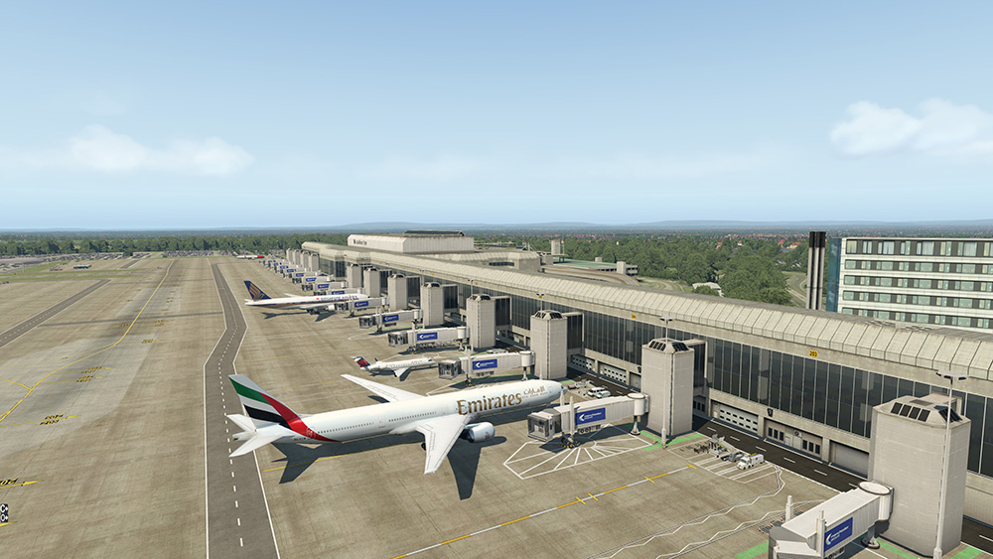
Project Overview

